Slide 1
Revisiting Crimes of the Powerful: a global conversation on capitalism, corporations, and crime
“Shadow Boxing against the Crimes of the Powerful”
Margaret E. Beare
mbeare@osgoode.yorku.ca

Slide 2
Question?
How did we get to the point of minimizing the significance of corporate crimes that do so much harm?

Slide 3
Three shifts in how we think about corporate crimes:
#1 From serious criminal activity to a focus on ‘who’ is doing the harmful activity—i.e. separation of mobsters from white-collar criminals.

Slide 4
Consequence of the creation of the ‘white-collar crime’ concept …(Edwin Sutherland: 1939)
Separation of organized crime
Businessmen/Politicians Mobsters
who commit crimes
Real organized crime
White-Collar, Corporate/regulatory violations

Slide 5
#2 From criminal ‘harm’ to ‘criminal intent’ i.e. the factory owner did not intend for the locked building to collapse. Occupational murder becomes ‘business as usual’.
#3 From the embeddedness of capital to the focus on individual enablers—’bad apple’ lawyers, accountants, individual bureaucrats , rather than the capitalistic system as a whole.

Slide 6
The Players: “collars of many colours” (should never have been resisted to ‘white’)
“If officials operate like racketeers, then they are racketeers”.
G. Robert Blakey (who drafted the U.S. RICO Statute):
Beyond the ‘usual suspects’. ..
You may be dealing with a network of criminals who are involved in an ongoing criminal conspiracy, where everyone is profiting and everyone deserves the same ‘mobster’ or at least ‘criminal’ label.

Slide 7
To illustrate Blakey’s original quote: you can be a racketeer regardless of the colour of your collar!
May 2013 Canadian criminal association case that revealed the easy cross-over between high profile officials and racketeers.
Those convicted under Canada’s organized crime legislation included:
former Laval Mayor Gilles Vaillancourt (so called “King of Laval”),
former city manager Claude Asselin, and
former director of engineering Claude Deguise.
Vaillancourt was alleged to have headed an “organized and structured network” of corruption and collusion.
He was singled out for allegedly having “instructed others to commit offences for the benefit of a criminal organization”, suggesting he was the ringleader. All were charged with gangsterism among other charges.

Slide 8
The Breadth of the Canadian CC
Three offences, now found under section 467.11, 12, and 13 of the Criminal Code
All three categories are part of the criminal conspiracy:
Participating in (or facilitate) activities of criminal organizations;
Commission of an offence for a criminal organization; and
Instructing the commission of an offence for a criminal organization.

Slide 9
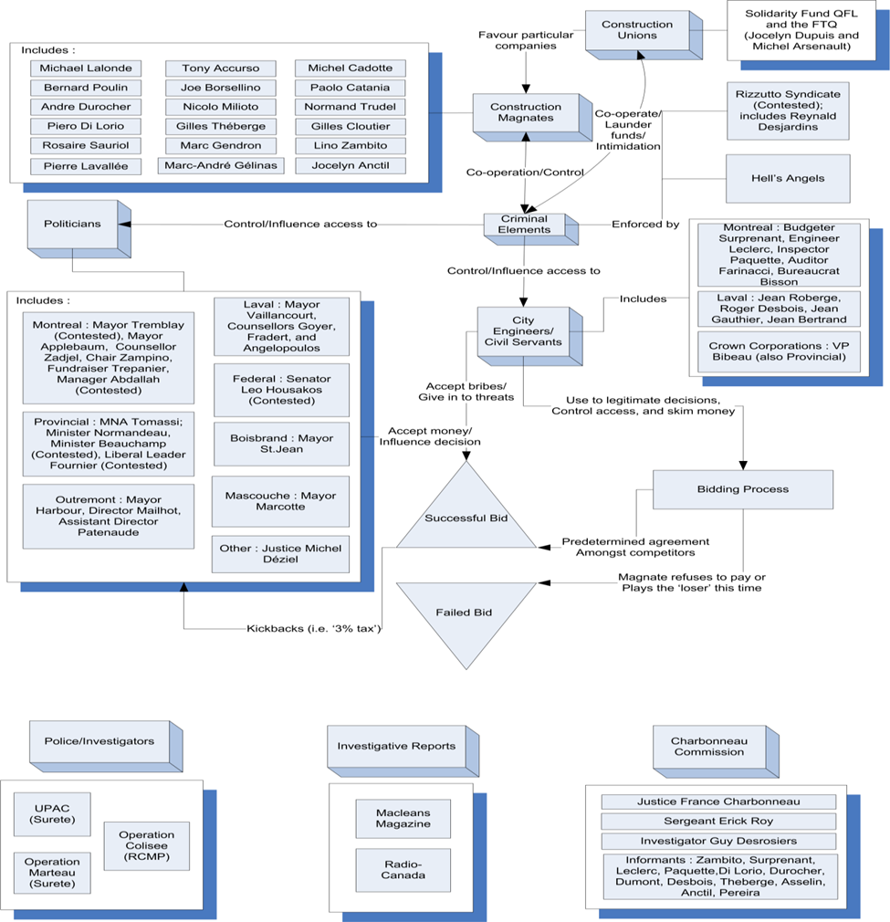

Slide 10
Enablers with benefits…
‘Enablers’ in the form of lawyers, accountants, and officials in key ‘access’ positions not only facilitate corporate crimes but are also often the beneficiaries.
These facilitators are not always merely ‘hired’ experts but may be the creators and drivers of the international schemes and set-up and head the criminal corporate operations.

Slide 11
World Economic Forum’s report on ‘Enablers’ of Organized Crime and Money Laundering
In 2012 they identified the role of “professionals” and non-transparent “beneficial ownership” as two of the main enablers of illicit money possession and movement.

Slide 12
Lawyers…
Quoting Doreen McBarnet regarding corporate ‘creative compliance’:
“…far from seeing the law as an authoritative and legitimate policy to be implemented, see it as a material to be worked on, to be tailored, regardless of the policy behind it, to one’s own or one’s client’s interests. And it requires active legal work”.

Slide 13
Doreen McBarnet:
"To suggest then that the key to staying on the right side of the line is `not what you do but the way that you do it', is not to imply simply a distinction in style, a matter of cleverness or moral choice, but to underline the significance of opportunity and resources. Manipulating the law to escape control yet remain legitimate is an option more readily available to large corporations and 'high net worth' individuals than to the mass of the population".

Slide 14
Professionals in Laundering

Slide 15
Canadian Lawyers…
The exclusion of lawyers from mandatory suspicious reporting and the right of defense lawyers to benefit from criminal proceeds throws into question the sincerity of those in government who push the anti-money laundering initiative.
(Yes—negotiations have taken place regarding alternative accountability processes but, still basically exempt from the requirements that are placed on other professional and business operations.)

Slide 16
February 2015… Solicitor-client Privilege is Safe
In considering the positions raised by both the federal government and that of the Federation in Canada (Attorney General) v. Federation of Law Societies of Canada, 2015 SCC 7, all seven Supreme Court justices (in a rare ‘by the Court’ decision) found the Federation’s arguments to be more persuasive, and ruled in its favour.
…five members of the Court also found that a lawyer’s duty of commitment to his or her clients’ interests was a principle of fundamental justice, and that requiring lawyers to report on their clients’ activities, or permit state agents to access confidential information without proper legal authority, would violate that principle.
http://www.shk.ca/solicitor-client-privilege-is-safe-scc-confirms-that-lawyers-files-are-exempt-from-unconstitutional-searches/

Slide 17
Getting behind the corporate wall…beneficial ownerships

Slide 18
Beneficial ownership…critique of Canada
During 2016 at least 4 separate reports drew attention to Canada’s failure to facilitate the identification of beneficial ownerships of corporations:
2016 FATF peer review of Canada
International Bank of Reconstruction and Development and the World Bank
Transparency International
OpenCorporates
These reports ranked Canada either ‘weak’ or in one case ‘the worst’!

Slide 19
FATF—peer review on Canada 2016…weaknesses
In addition to the issues with the lawyers…
supervision of real estate (low numbers of suspicious transaction forms submitted by real estate sector—many agents appear to be unaware of their obligations.)
dealers in precious metals and stones
regulations related to politically exposed persons (PEPs)
the identification of beneficial ownerships—procedures have been strengthened but problem remain. Businesses and professionals who are obligated to comply with AML/CFT obligations do not have to identify the beneficial ownership nor take special measures with respect to PEPs.

Slide 20
Justice Charbonneau (2016) & Justice Gomery (2006) concluded…
2016: “a culture of impunity” took over a vast section of Quebec’s public tendering in construction in which organized crime, political figures and bureaucrats, political parties, unions and entrepreneurs worked together to skim public funds to illicit ends. (Liberal in power when Commission was called but mandate also covered PQ era—both parties were nervous!)
2006: “a culture of entitlement” had developed. A decade prior—the Gomery sponsorship inquiry concluded that the party in power (Liberals) engaged in bribery and collusion without remorse and perpetuated a partisan, corrupt contracting system that made friends rich and paid party bills.

Slide 21
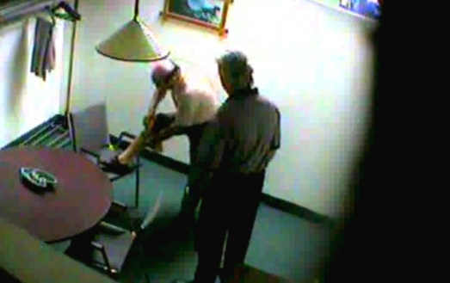
Could the RCMP have missed this…?
Reputed former godfather of the Mafia in Montreal, Nicolo Rizzuto Sr., stuffs cash into his sock while Montreal construction entrepreneur Accursio (Alex) Sciascia watches …

Slide 22
Enforcement (or non-enforcement) of Corruption
Priorities of the RCMP are most dramatically illustrated in their single focused devotion to targeting the Rizzuto involvement in drug trafficking:
Quoting RCMP Corporal Sebastiano at the Commission: “the tapes kept rolling but we weren’t listening”

Slide 23
Nigel Hadgkiss…director of the Fairwork Building and Construction agency (Australia) (following a career as Assistant Commissioner in the Australian Federal Police, and National Director, Intelligence in the Australian Crime Commission)
joked that in being brought back into the fray of helping to eliminate union corruption in the Australian construction industry, he was “leaving the tranquil world of organised crime for the construction industry”
The Saturday Age, Melbourne. 04 Oct 2014, by Simon Schluter. “Strike Back” (www.copyright.com.au)

Slide 24
Prosecuting Corruption…
Corruption cases are equally hard to prosecute here as in the US, in terms of meeting the standard of proof beyond a reasonable doubt of the element of the offense.
Bribery of officers and judicial officers
Fraud against the government
Municipal corruption All require
Selling or purchasing office some type of
Influencing or negotiation appointments quid pro quo
Secret commissions exchange
(CC 119 -125)

Slide 25
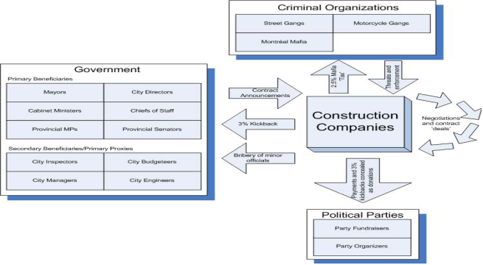
Money flow linkages of on-going ‘normalized’ exchanges (charts prepared by Michael Cifelli)

Slide 26
York University in Toronto received a $20 million donation for the creation of the Dahdaleh Institute for Global Health. The Panama Papers confirm, as long suspected, that Victor Phillip Dahdaleh served as ‘the mystery middleman’ known as "consultant A" in a series of U.S. court documents that lay out a decades-long kickback scheme involving global aluminum giant Alcoa and government officials in Bahrain. The role of the Royal Bank of Canada is scattered amount the Panama paper documentation on these cash exchanges. The U.S. officials allege that Dahdaleh ‘enriched himself’ with $400 million in markups via the paying of bribes. Dahdaleh settled a billion-dollar U.S. civil lawsuit—but has never been convicted. ***York gave him an honourary doctorate and in his address to the graduates at commencement (2016) he advised the graduates to: “appreciate the power of trust, staying true to one's values and giving back to the community”.
Corruption cases close to home…Do we care??

Slide 27
Mr. Vasos Georgiou
2004 Vas Georgiou, was vice-president and later interim CEO at St. Joseph’s Hospital in Toronto. But outside of his day job, he was working for a private family construction company.
in 2005---described as being one of the most powerful and most connected members of the hospital. Georgiou took a top position in Ontario’s procurement agency—Infrastructure Ontario
In 2011 Georgiou, admitted to creating false invoices that were used in a kickback scheme at York University. York University concluded it had been the victim of a $1.2-million fraud. Georgiou was not charged criminally and reached a settlement with the University.
Within a year, Georgiou got a top job at St. Michael’s Hospital, where he presided over the construction of a $300-million patient tower.
Nov. 2015 Georgiou was terminated ‘with cause’ from his position as vice president of St Michael’s Hospital—but only following a media investigation
His colleague at St Joseph’s, Ms. Bahl, hired Georgiou’s construction firm after he left that hospital. She became a senior executive overseeing a $400 Million re-development project at Markham Stouffville Hospital—where she hired her husband and her uncle’s businesses.

Slide 28
Fiscal Accountability in Construction Projects…
One example of a fairly ‘ordinary’ Phase 1 $300 million Public/Private/ Partnership healthcare project:
Infrastructure Ontario working with six separate law firms, with teams headed by at least 13 different lawyers.
a team of financiers, which included a trust company; an international bank; a Canadian bank and a Canadian Life Assurance Company.
contractors, friends of contractors;
bureaucrats and politicians who all have an interest in the project.

Slide 29
Infrastructure and corruption…
In the March 2016 federal budget the Canadian government announced a $120 Billion infrastructure plan.
Likewise, Ontario is making the largest investment in public infrastructure in the province's history -- about $160 billion over 12 years.
Many of these large- scale projects are public-private partnerships (P3s) rather than one-directional contracts.
The Auditor General’s 2014 Report on P3s in Ontario found among other damaging discoveries that there's very little competition among the large P3 general contractors—5 contractors did 80% of the projects and where there was a maintenance component two of the facility management companies were awarded the majority of the P3 projects.
The large-scale re-development projects involving Health Centres/Hospitals appear to be particularly negligent in there procurement dealings.
Brings us to…

Slide 30
Infrastructure Bank…Toronto?
Aim is to attracts the world’s most powerful institutional investors with trillions of dollars at their disposal to invest in Canada.
Focus will be on private-public partnerships…
In addition to the infrastructure bank, the government also intends to create a new “Invest in Canada Hub” for attracting foreign investment and it plans to relax some restrictions on foreign investment.

Slide 31
Bankers in Canada (and elsewhere) Why might banks not care about illicit money???
(beyond meeting their minimum legal requirements)
Profit orientation of banks,
share-holder obligations,
the ‘neutrality’ of the appearance of dirty money---all work against a focus on money laundering.
The difficulty in identifying suspicious ‘dirty’ money and the impossibility of identifying ‘good legitimate money that might be used for terrorist activities’.
Answer has been big fines vs. criminal sanctions… “Punish them with fines” has been the response while ignoring:
In U.S. three of the four largest financial institutions are 80% bigger today than they were before they were bailed out.

Slide 32
‘Off-shore’ is very often very much ‘on-shore’
1999: Russian mafia `laundered $10bn at Bank of New York'
Billions of dollars have passed through the bank in the past year in what could be the biggest money-laundering operation detected in the United States. The bank, one of the oldest in America, acknowledged that the funds originated in Russia, where organised crime is rife in banking circles.
**Bank paid $26 Million ‘non-prosecution fine and $12 Million to others affected by the laundering.

Slide 33
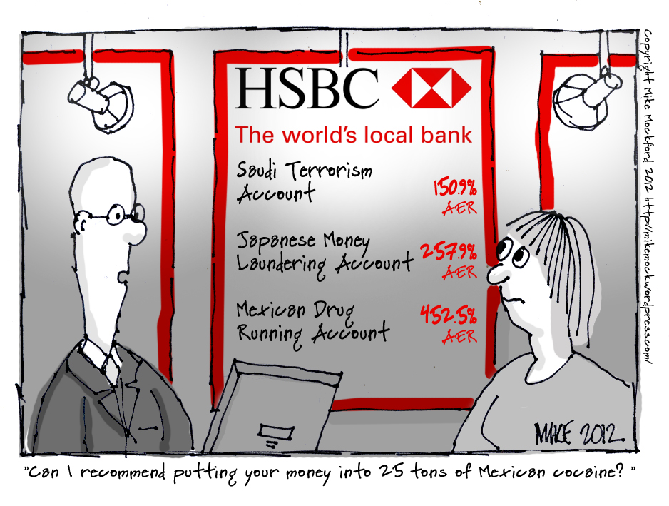
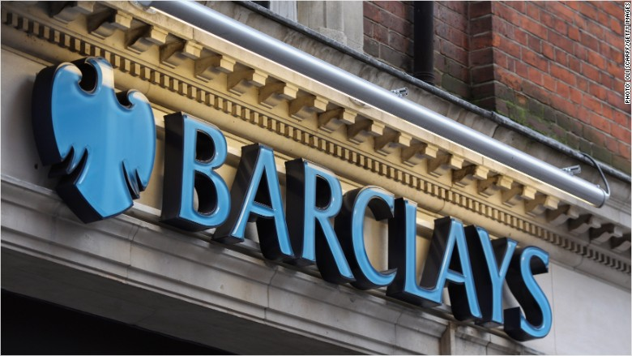
Who are we catching?
2012 & 2015: The US government decided not to pursue criminal charges against HSBC for allowing terrorists and drug dealers to launder millions of dollars. Regulators intervened to warn that prosecuting Britain’s biggest bank could lead to a “global financial disaster”…
**Instead of pursuing a prosecution, the bank agreed to pay a record $1.92bn fine.

Slide 35
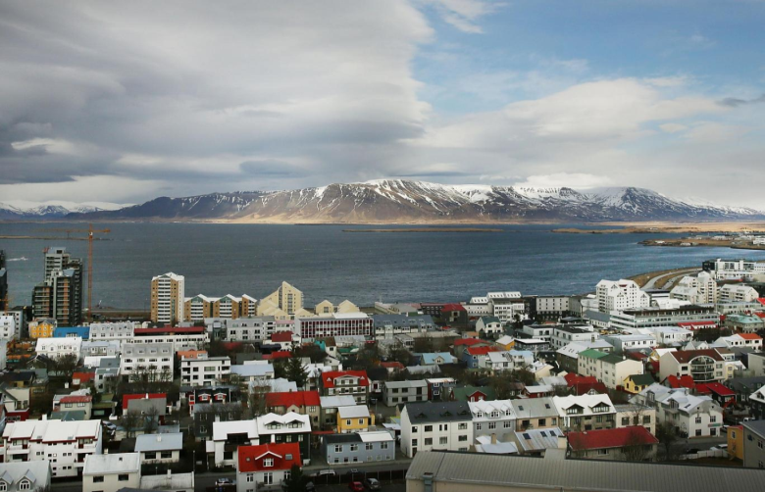
The exception: Iceland sentencing 9 bankers found guilty of market manipulation that helped caused 2008 crash (Independent, Friday 7 October 2016
The Supreme Court in Reykjavik returned guilty verdicts for all nine defendants in the Kaupthing Bank market manipulation case.
“By allowing bankers to be prosecuted as criminals, Iceland opted for a different strategy in the wake of the financial crisis to rest of Europe and the US, where banks were fined, but chief executives escaped punishment.”

Slide 36
Panama papers…
Data was obtained from Panamanian law firm Mossack Fonseca
The consortium estimates there are 1,352 corporate “officers” linked to Canada in the documents.

Slide 37
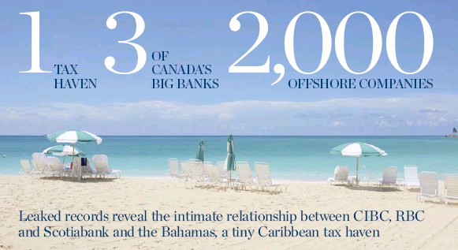
Canada: Registered Companies RBC 847 CIBC 632 Scotiabank 481 (Toronto Star Sept. 22 2016)

Slide 38
What are our regulatory agencies doing…

Slide 39
FinTRAC: They have fined Only 1 Canadian bank, (April 2016)
Name of bank was kept secret—with each bank claiming ‘it wasn’t them’! (Eventually shown to be Manulife)
Fintrac’s home page shows the name of many smaller violators i.e. companies such as jewelry stores, independent securities dealers and real estate brokerages—not the bank.
Explanation for confidentiality: Fintrac’s Gibb said the legislation is not meant to be punitive, but aimed at changing non-compliant behaviour.
Again, this does not apply to those without the resources to fight Fintrac. Crimes of the most powerful are treated differently.
A better explanation: an agreement struck between Fintrac and the institution that in exchange for anonymity, the institution may have agreed to forgo a lengthy appeal process in the courts and pay the $1,154,670 fine.

Slide 40
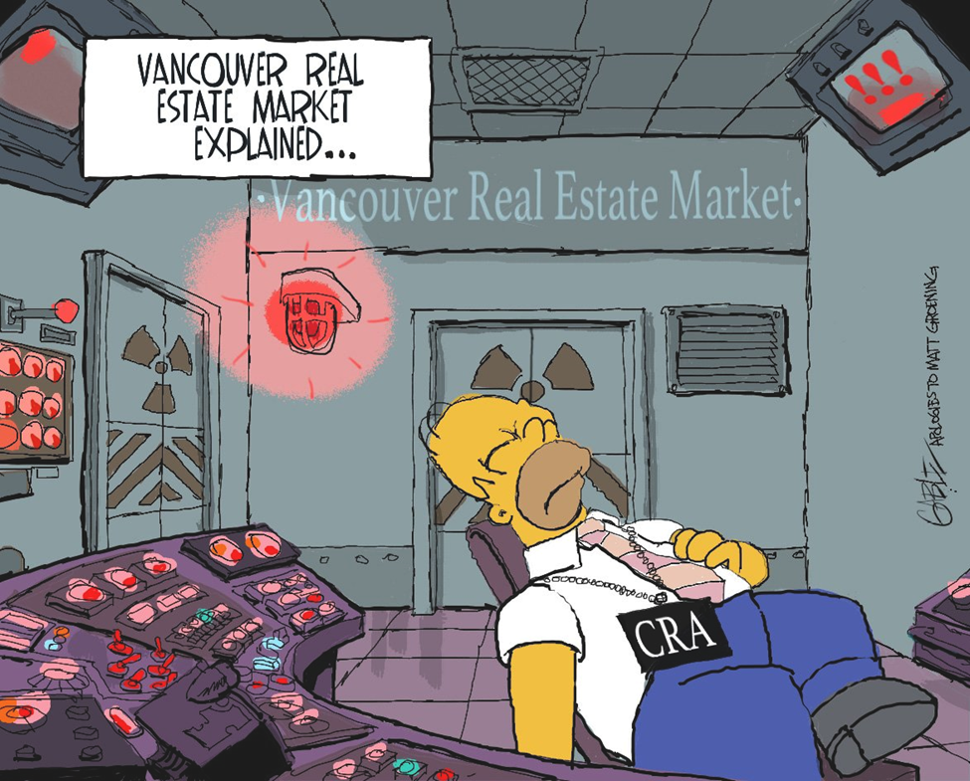

Slide 41
Revenue Canada & KPMG: the offshore tax "sham" on the Isle of Man
A tale that should enrage the public…the Canada Revenue Agency offered a secret amnesty deal to multi-millionaire clients of KPMG
CBC was leaked a copy of the confidential agreements that went first to KPMG who then passed them on to their high net worth clients.
If they self-identified, in lieu of fines and penalties—or conviction—for their involvement in the controversial scheme, ‘high net worth’ clients, and only the wealthy clients, simply had to agree to pay their back taxes and in some cases a modest interest on these offshore investments.
Revenue Canada stated that the agreements could be terminated by the CRA if the KPMG clients spoke to others about the secret offer.

Slide 42
Democracy at work…
As Revenue Canada acknowledged: it would not be advantageous for the tax paying public to learn that there were different systems of accountability at work!
Why did Revenue Canada do this?
The self-identification of the wealthy clients would result in some tax revenue. The amnesty process would free up Revenue Canada to go after the smaller clients who would not have the resources to engage in long court battles with high-priced lawyers.
Similar to FINTRAC, Revenue Canada appears to have made the decision to avoid the expensive legal battle with high-net worth individuals i.e. the crimes of the powerful.

Slide 43
When do we care … about the illicit movement of Money and Corruption
When…
Canada receives international pressure regarding our failure to meet their various agreed requirements i.e. the FATF peer reviews. ***However, we must wait to see how the Canadian government meets the criticism regarding the exemption of lawyers and the failures regarding beneficial ownership.
Funds point toward “terrorist financing”---but then we handle it as if it were money laundering i.e. responsibilization of front line tellers etc.
When it is ‘really’ tax evasion—unless the client is too big to jail i.e. KPMG’s clients.

Slide 44
Dealing effectively with corporate crime…
Many of the enforcement issues are seemingly insurmountable… HOWEVER…many merely require political will.
Prioritizing corruption cases—by the police and regulators
Draft anti-corruption laws that are enforceable
‘Fix’ the issue of the exemption of lawyers from suspicious transaction reporting and the lack of transparency of beneficial ownerships.
Accept that certain industries are vulnerable to corporate crimes—i.e. construction for one (and perhaps specifically ‘Public Private Partnership’ arrangements) –and therefore spend time worrying about the monitoring and oversight of these projects.

Slide 45
The End… Thank you Margaret E. Beare mbeare@osgoode.yorku.ca

